Slide 1
24 April

Slide 2
Aim
Forecast Fnb Index
Using dynamic regression
ARIMA shows non-stationary, differencing is required
Multiplicative regression unable to account for autocorrelation

Slide 3
Making dataset
Data range: 2006,1 to 2016,12 (132obs); 2017,1 – 2019,12 (36obs)
Absolute, Absolute_SA, rate, rate_SA
For SA, use stl(x, s.window=13)
For rates, use percentChange()
For quarterly data, repeat data by 3 times. For annual data, repeat data by 12 times
For seasadj data, perform stl first before repeating

Slide 4
Variables
Fnb – Forecast variable – Absolute, SA absolute, growth rate, SA growth rate
RSI – RSI absolute, SA absolute, growth rate, SA growth rate
Population [annual] – absolute, absolute, growth rate, growth rate
Tourism – absolute, absolute SA, growth rate, SA growth rate
Food employment – changes, changes SA, rate, SA rate
Services employment – changes, changes SA, rate, SA rate

Slide 5
Summary
Regression | Model | p-Val | AICc | RMSE | RMSE_forecast
1 | (2,1,0)(0,0,2)[12] | 0.2499 | 595.89 | 2.06 | 5.1921
2 | (1,0,2)(0,1,1)[12] | 0.2899 | 575.77 | 2.29 | 2.56
3 | (1,0,2)(0,1,1)[12 | 0.2734 | 575.53 | 2.295 | 2.44

Slide 6
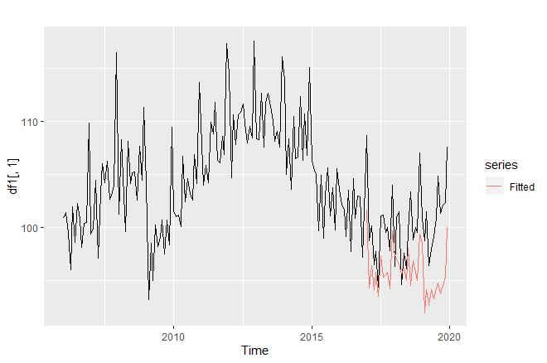
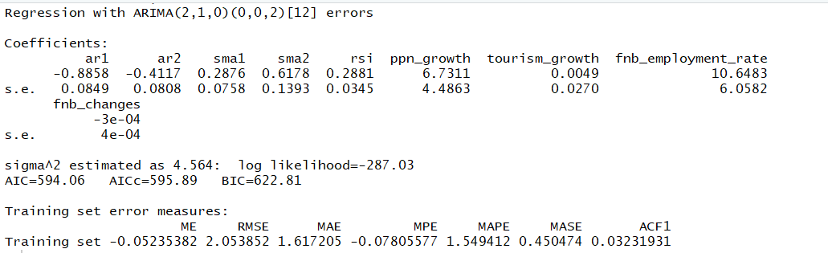
Regression 1
df1
Fnb ~ RSI + population rate + tourism rate + food changes + food rate

Slide 7
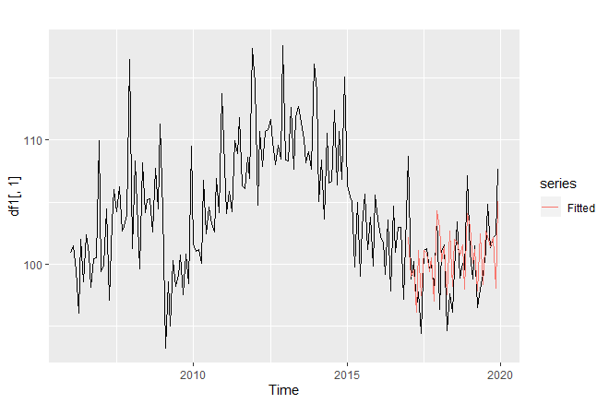
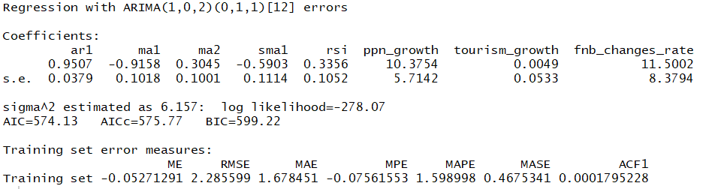
Regression 2
df2
Fnb ~ RSI_SA + population rate_SA + tourism rate_SA + food rate_SA

Slide 8
27 April

Slide 9
Aim
Forecast Fnb Index
Using multiplicative regression
Compare diff(fnb) and rates for fnb
Compare diff(predictors) and rates for predictors

Slide 10
Summary
Regression | Model | p-Val | AICc | CV | Adj R2
1 | Spurious | 0.000415 | 366.13 | 8.814 | 0.91
2 | Differencing for all | 4.243e-07 | 357.21 | 8.366 | 0.63
3 | Rates for all | 6.718e-07 | 370.03 | 8.85 | 0.65
4 | Differencing for FSI only | 5.821e-08 | 374.430048 | 9.170836 | 0.589456
5 | Differencing for FSI + rates for predictors | 5.248e-07 | 355.3451050 | 8.1966400 | 0.6337918
6 | 5 + lag | 0.8523 | -1.162153e+04 | 6.040874e-31 | 1.000000e+00
7 | Dynamic regression | 0.3177 | 548.04 | RMSE = 2.09 | RMSE_f = 2.91

Slide 11
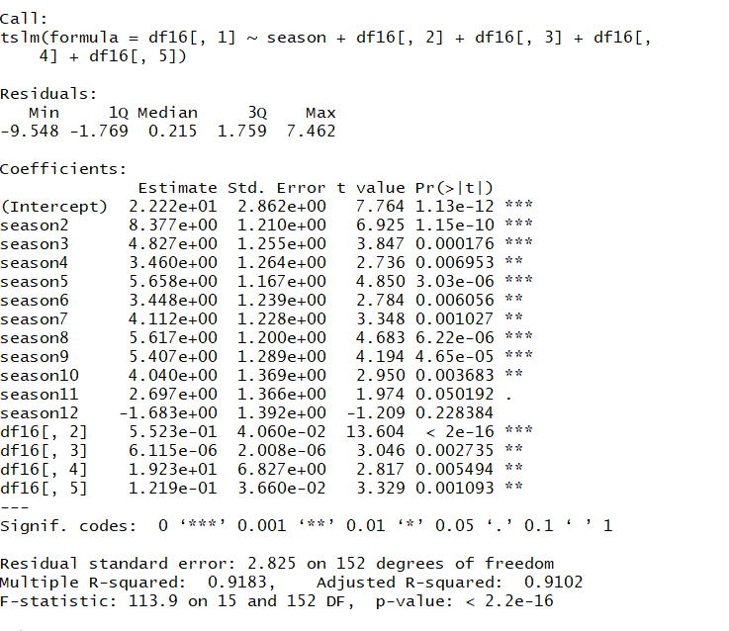
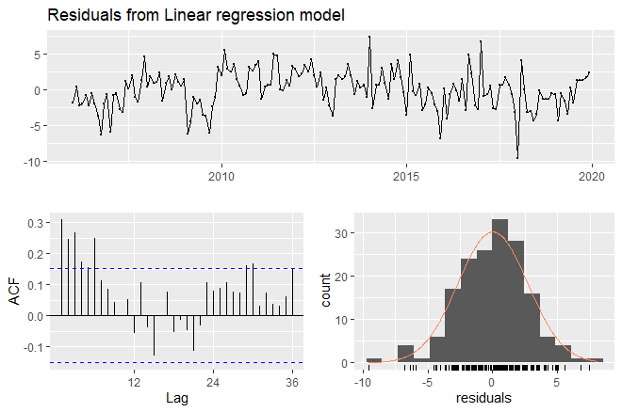
Regression 1
Spurious regression
Fnb ~ trend + season + RSI + tourism + food changes + ipi

Slide 12
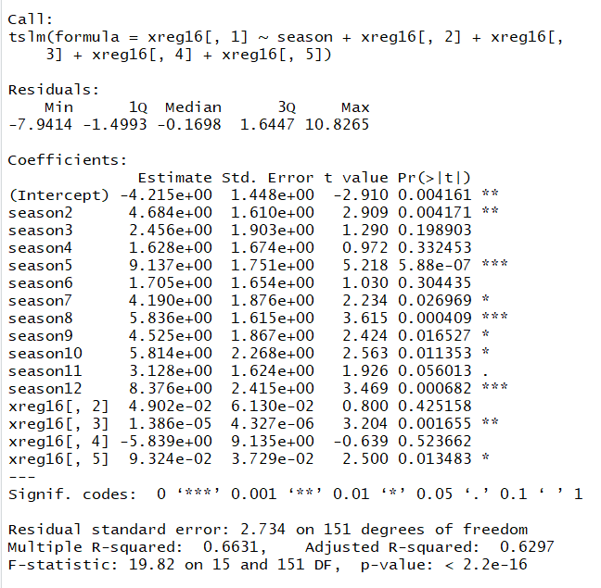
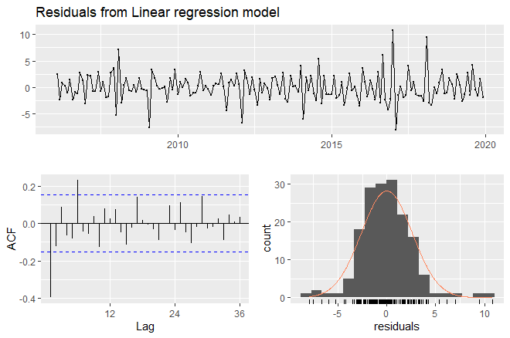
Regression 2
Differencing for all
Fnb ~ trend + season + RSI + tourism + food changes + ipi

Slide 13
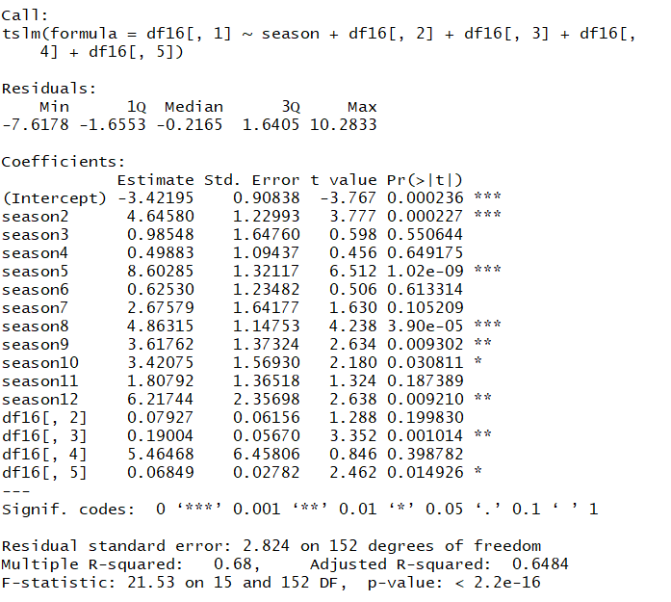
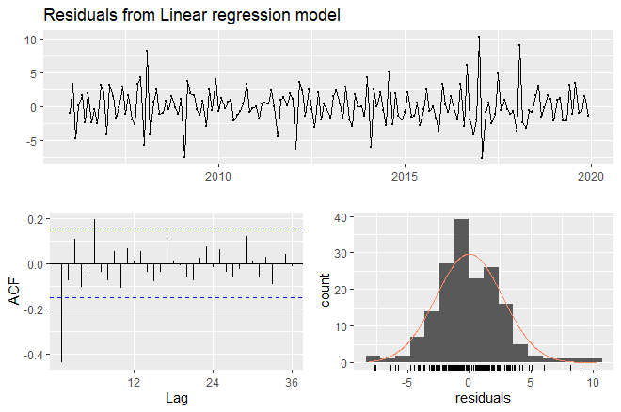
Regression 3
Rates for all
Fnb ~ trend + season + RSI + tourism + food changes + ipi

Slide 14
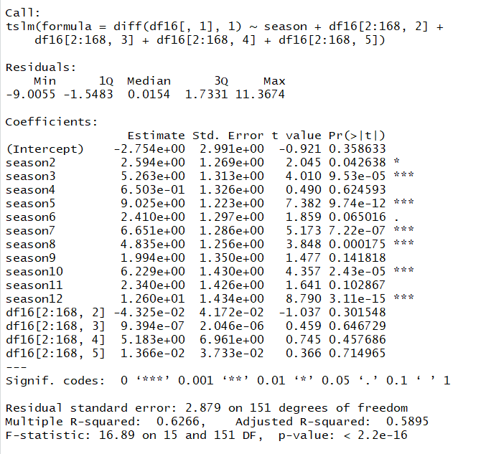
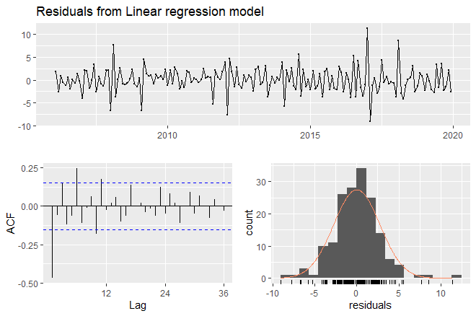
Regression 4
Differencing for FnB, absolute predictors
Fnb ~ trend + season + RSI + tourism + food changes + ipi

Slide 15
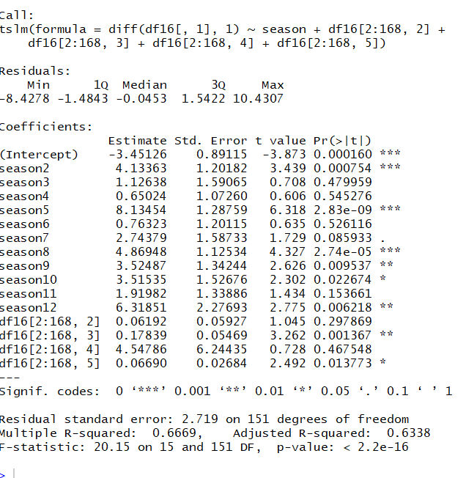
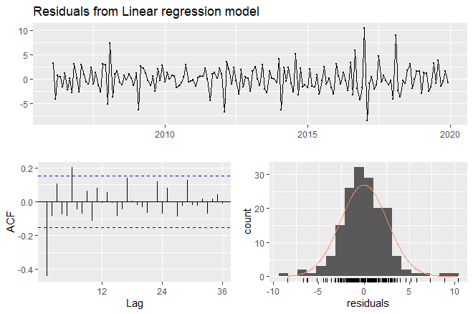
Regression 5
Differencing for FnB, absolute predictors
Fnb ~ trend + season + RSI + tourism + food changes + ipi

Slide 16
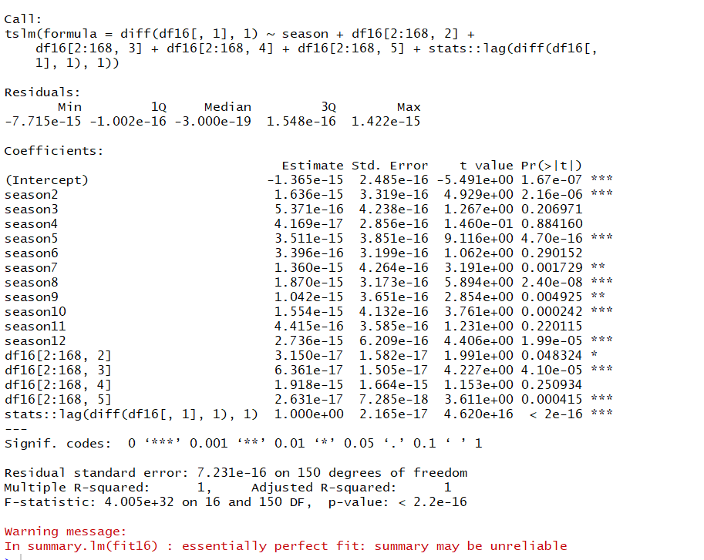
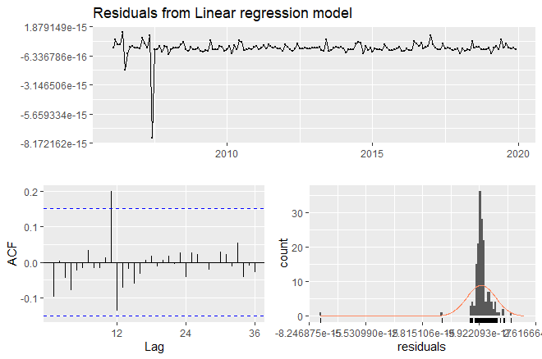
Regression 6
Differencing for FnB, absolute predictors + lag
Fnb ~ trend + season + RSI + tourism + food changes + ipi + lag(fnb)

Slide 17
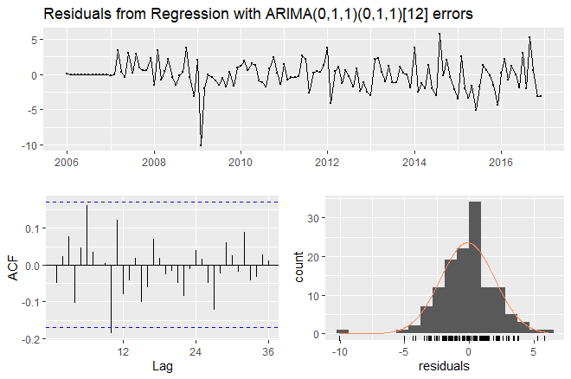
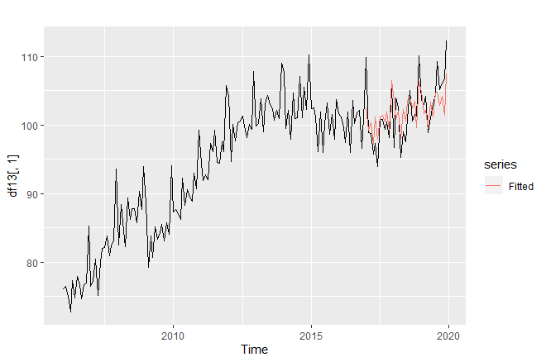
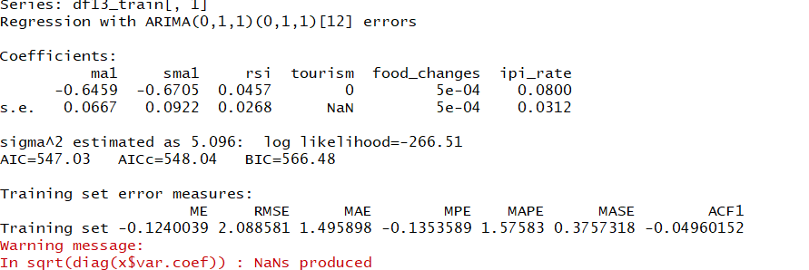
Regression 7
Dynamic regression
Fnb ~ RSI + tourism + food changes + ipi

Slide 18
Regression 7

